Slide 1

Object Oriented Programming
Lec # 4 : Structures

Slide 2
Abstract Data Type
You have seen many primitive data types like int, float, double, bool etc.
An abstract data type (ADT) is a data type created by the programmer and is composed of one or more primitive data types.

Slide 3
Abstract Data Type
So far you’ve written programs that keep data in individual variables.
If you need to group items together, C++ allows you to create arrays.
The limitation of arrays, however, is that all the elements must be of the same data type.
Sometimes a relationship exists between items of different types of elements.

Slide 4
Abstract Data Type
Their definition statements do not make it clear that they belong together.
Variable Definition | Data Held
int empNumber; | Employee number
string name; | Employee’s name
double hours; | Hours worked
double payRate; | Hourly pay rate
All these variables hold data about the same employee

Slide 5
Combining Data into Structures
Structure: is a user-defined data type. It is like a container that allows multiple variables to be grouped together. Structures are used to organize related data (variables) into a nice neat package.
Variables can be of any type
struct structName
{
dataType field1;
dataType field2;
. . .
};

Slide 6
Introducing Structures
A structure is a collection and is referenced with single name.
The data items in structure are called structure members, elements, or fields.
The difference between array and structure: is that array must consists of a set of values of same data type but on the other hand, structure may consist of different data types

Slide 7
Example struct Declaration
struct Student
{
int studentID;
string name;
short yearInSchool;
double gpa;
};
Organize related data (variables) into a nice neat package (single unit)
structure name
structure members

Slide 8
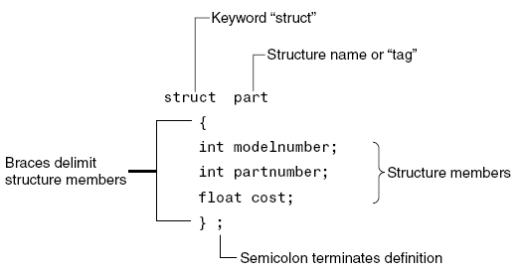
Structure Definition Syntax

Slide 9
struct Declaration Notes
Made in global scope usually, so can access the user-defined datatype in all functions
Must have ; after closing }
struct names commonly begin with uppercase letter
Multiple fields of same type can be in comma-separated list:
string name, address;

Slide 10
Creating struct Variables
struct declaration does not allocate memory or create variables
Must create a struct variable
To create variables, use structure name as type name
tom
Student tom;
studentID
name
structure name
variable name
yearInSchool
gpa

Slide 11
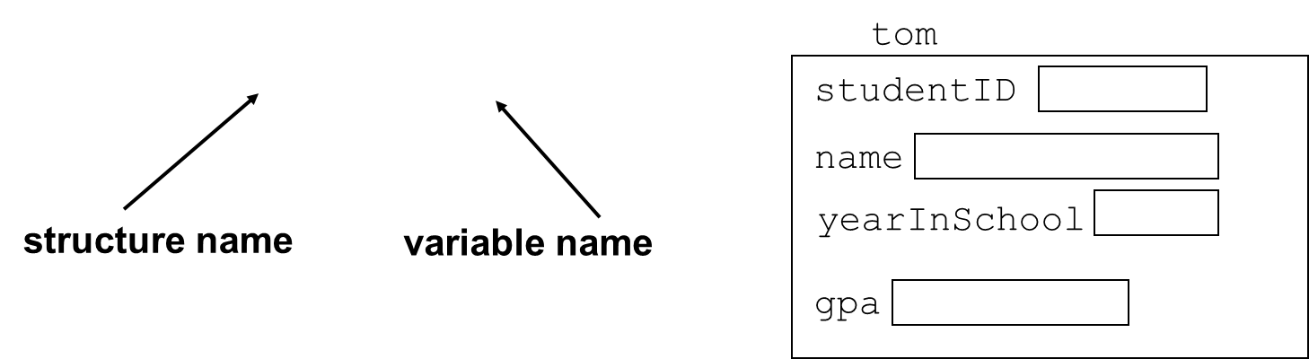
Creating struct Variables
Must declare a structure before creating a structure variable
Student tom;

Slide 12
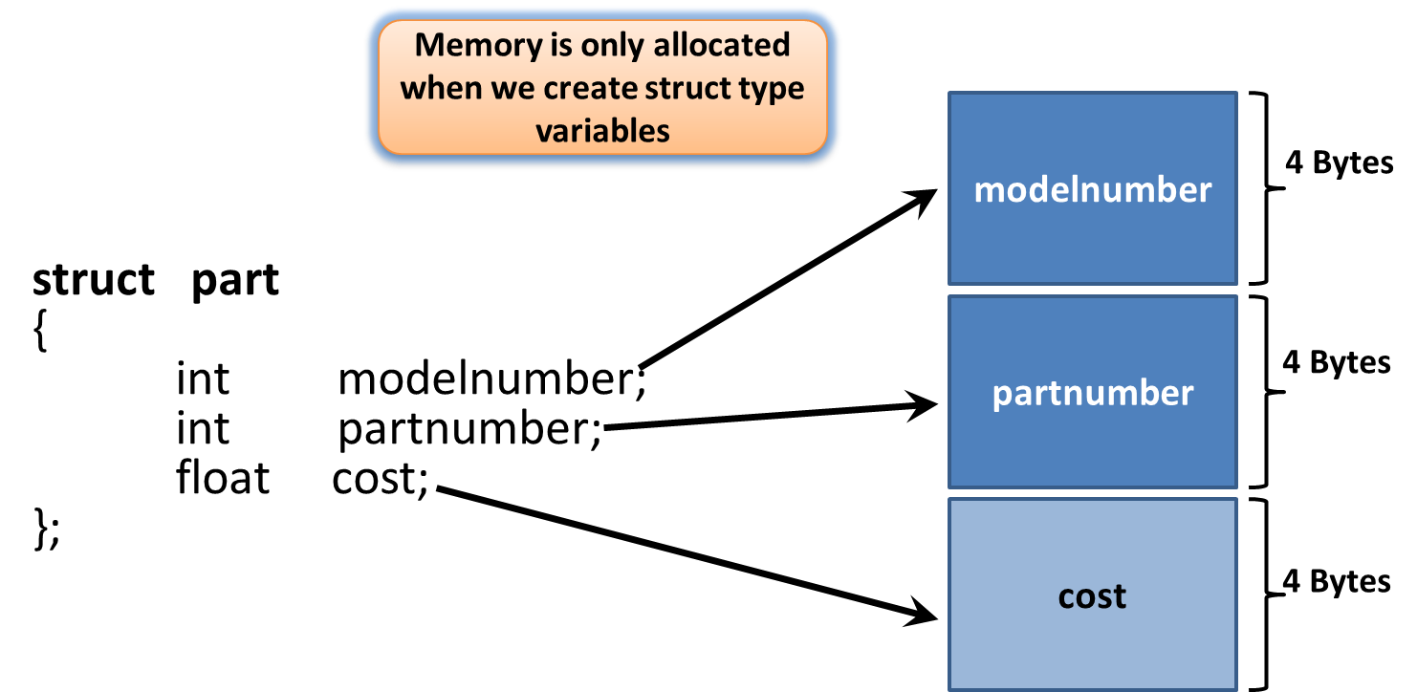
Structure Members In Memory

Slide 13
Creating struct Variables – Another way
Can also create a structure variable with its declaration
struct Student
{ int studentID;
string name;
short yearInSchool;
double gpa;
} student1;

Slide 14
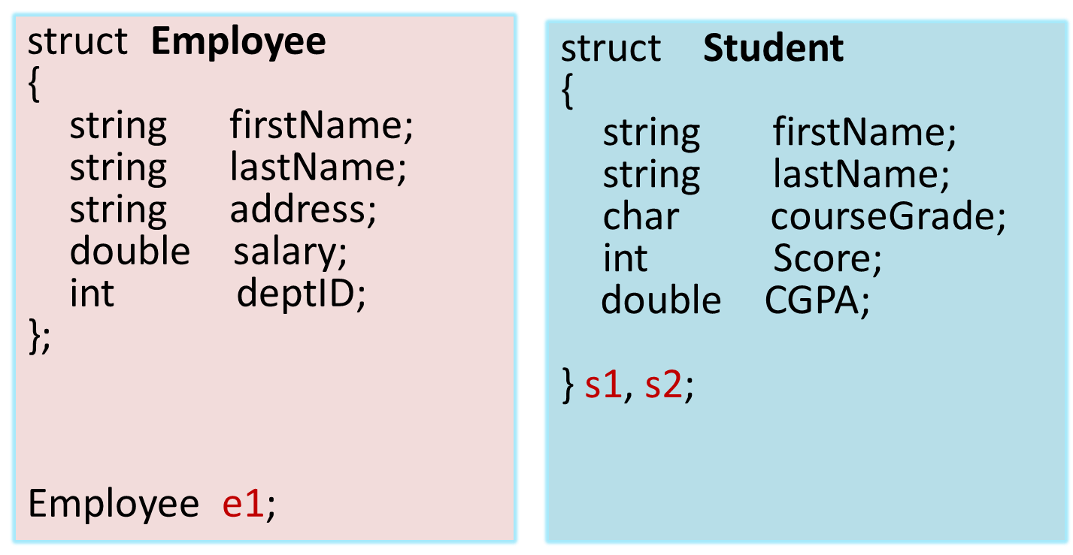
Creating struct Variables Two Ways

Slide 15
Initializing a Structure
The syntax of initializing structure is:
StructName struct_identifier = {Value1, Value2, …};

Slide 16
Initializing a Structure
Values should be in the same sequence as the structure
struct Student
{ int studentID;
string name;
short yearInSchool;
double gpa;
};
struct variable can be initialized when created
Student s1 = {11465, "Joan", 2, 3.75};

Slide 17
Accessing Structure Members
Use the dot (.) operator to refer to members of struct variables:
cin >> s1.studentID;
s1.name = “Alex Stone”;
s1.gpa = 3.75;
Member variables can be used in any manner appropriate for their data type

Slide 18
Assigning Values to Structure Variables
After creating structure variable, values to structure members can be assigned using cin
Output to screen using cout
student s1;
cin>>s1.firstName;
cin>>s1.lastName;
cin>>s1.courseGrade;
cin>>s1.marks ;
cout<<s1.firstName<<s1.lastName;

Slide 19
More on Initializing a Structure
May initialize only some members:
Student s1 = {14579};
Cannot skip over members:
// illegal
Student s1 = {1234, "John", , 2.83};

Slide 20
More on Initializing a Structure
You can also give default values inside a struct definition
struct Student
{
int studentID = 0;
string name = ““;
short yearInSchool = 1;
double gpa = 1.0;
};

Slide 21
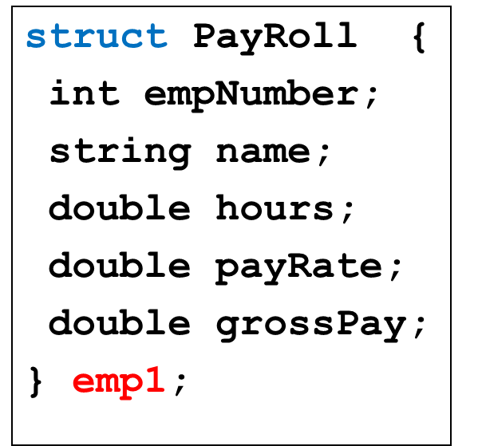
Accessing Structure Members
void main{
emp1.empNumber = 489;
emp1.name = “Jill Smith”;
emp1.hours = 23;
emp1.payRate = 20;
emp1.grossPay = emp1.hours * emp1.payRate;
}

Slide 22
Assigning one Structure Variable to another
structure variable can be assigned to another structure variable only if both are of same type
A structure variable can be initialized by assigning another structure variable to it by using the assignment operator as follows:
Example:
studentType Student1 = {“Amir”, “Ali”, ‘A’, 98} ;
studentType student2 = Student1;

Slide 23
Comparing struct Variables
Cannot compare struct variables directly:
if (s1 == s2) // won’t work
Instead, must compare on a field basis:
if (s1.studentID == s2.studentID)

Slide 24
Practice Question
Define a structure called “Car” in global scope. The member elements of the car structure are:
string Model;
int Year;
float Price
Create a variable of type Car called c1
Get input for all structure members from the user
Then the program should display complete information (Model, Year, Price) of c1

Slide 25
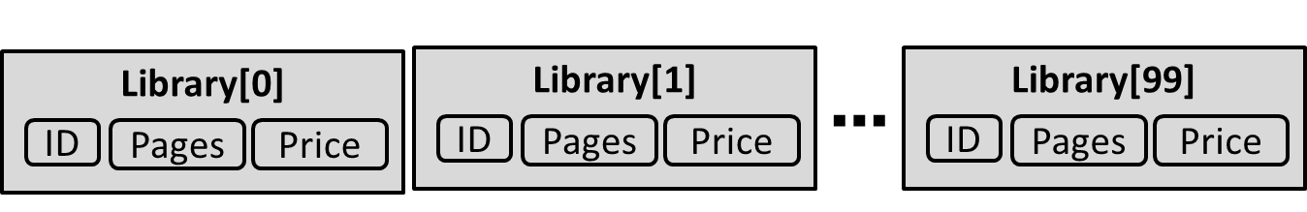
Array of Structures
An array of structures is a type of array in which each array element is a structure
struct Book
{ int ID;
int Pages;
float Price;
};
Book Library[100]; // declare array of structures

Slide 26
Initialization of Array of Structures
Can be used in place of parallel arrays
struct Book
{
int ID;
int Pages;
float Price;
};
Book b[3]; // declaration of array of structures

Slide 27
Initialization of Array of Structures
Initializing can be at the time of declaration
Book b[3] = {{1,275,70},{2,600,90},{3,786,100}};
Or can be assigned values using cin:
cin>>b[0].ID ;
cin>>b[0].Pages;
cin>>b[0].Price;

Slide 28
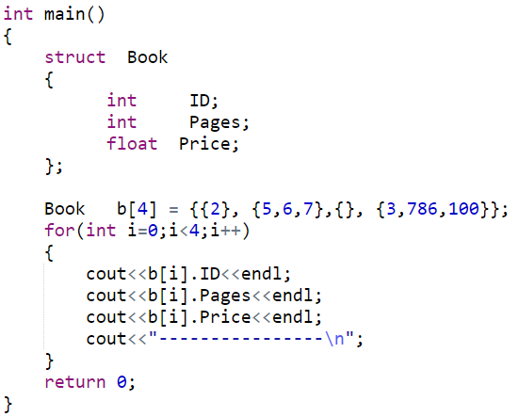
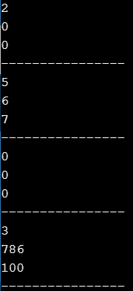
Partial Initialization of Array of Structures

Slide 29
Practice Question
Define a structure called “Car” in global scope. The member elements of the car structure are:
string Model;
int Year;
float Price
Create an array of 30 cars called showroom. Get input for all 30 cars from the user. Then the program should display complete information (Model, Year, Price) of those cars only which are above 500,000 in price.

Slide 30
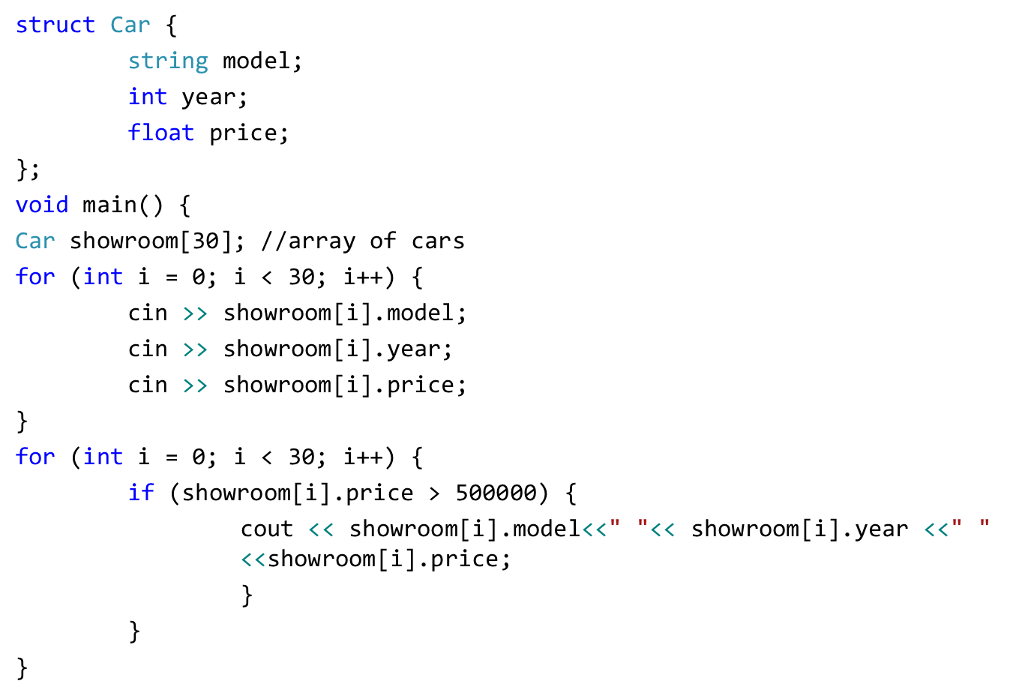
Practice Question

Slide 31
Array as Member of Structures
A structure may also contain arrays as members.
struct Student
{
int RollNo;
float Marks[3];
};
Initialization can be done at time of declaration: Student S = {1, {70.0, 90.0, 97.0} };

Slide 32
Array as Member of Structures
Can also assigned values later in the program:
Student s1;
s1.RollNo = 1;
s1.Marks[0] = 70.0;
s1.Marks[1] = 90.0;
s1.Marks[2] = 97.0;
Or user can use cin to get input directly:
cin >> s1.RollNo;
cin >> s1.Marks[0];
cin >> s1.Marks[1];
cin >> s1.Marks[2];

Slide 33
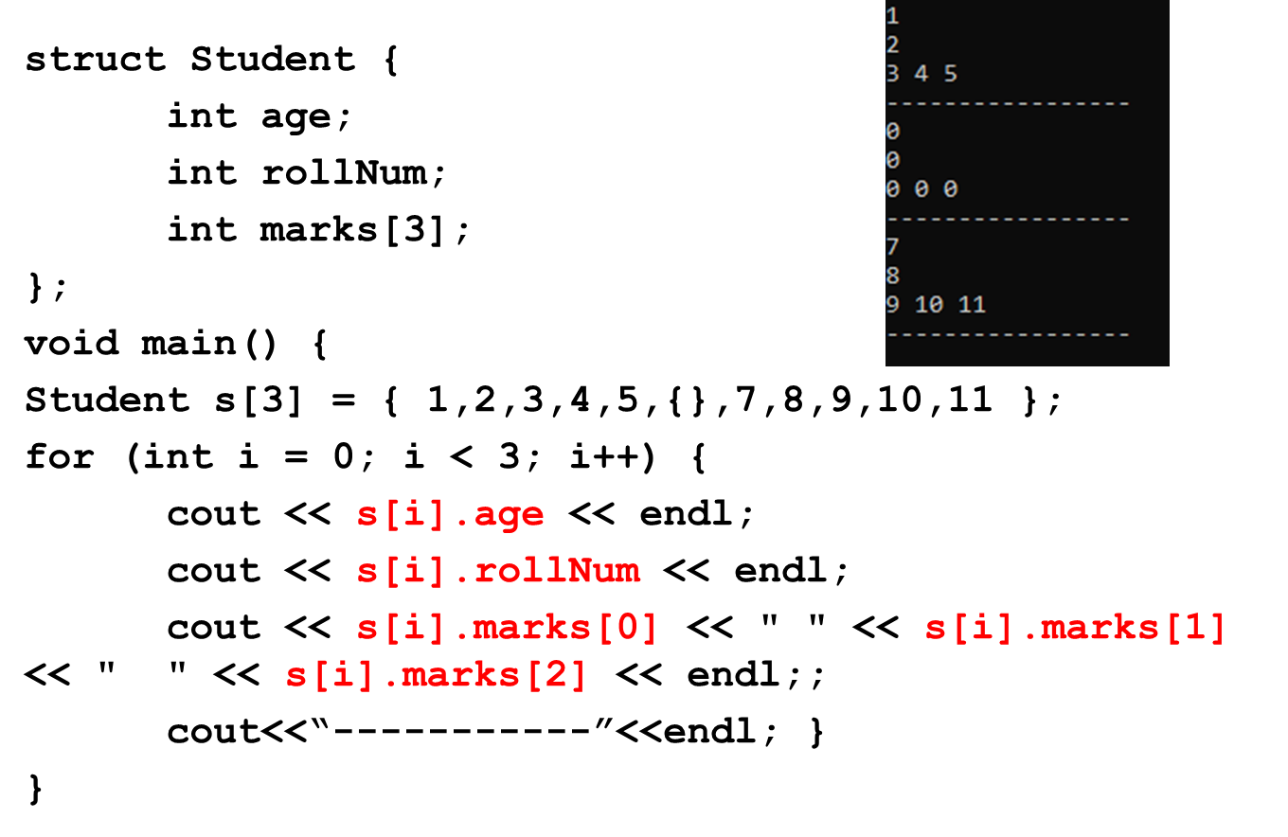
Array as Member of Structures

Slide 34
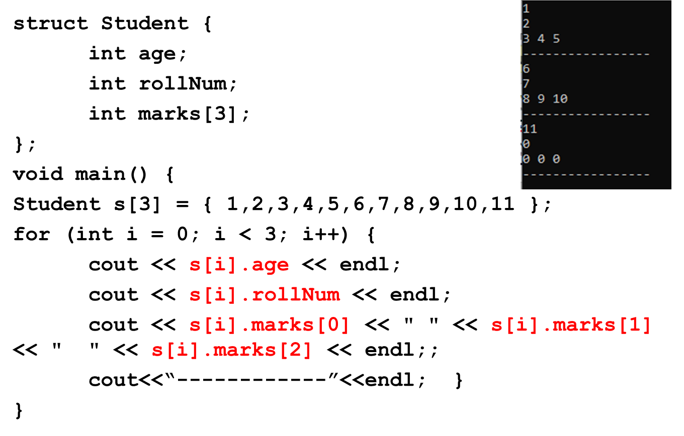
Array as Member of Structures

Slide 35
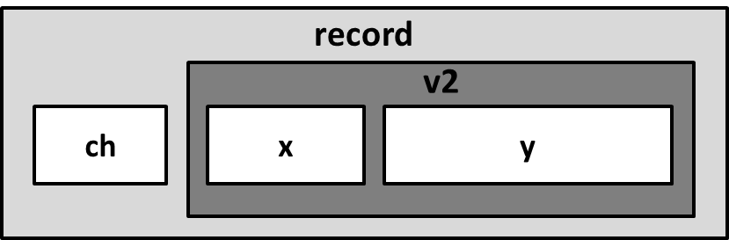
Nested Structure
A structure variable can be a member of another structure: called nested structure
struct A
{
int x;
double y;
};
struct B
{
char ch;
A v2;
};
B record;

Slide 36
Initializing/Assigning to a Nested Structure
struct A{
int x;
float y;
};
struct B{
char ch;
A v2;
};
void main() // Input
{
B record;
cin>>record.ch;
cin>>record.v2.x;
cin>>record.v2.y;
}
void main() // Assignment
{
B record;
record.ch = ‘S’;
record.v2.x = 100;
record.v2.y = 3.6;
}
void main() // Initialization
{
B record = {‘S’, {100, 3.6} };
}

Slide 37
Practice Question
Write a program that implements the following using C++ struct. The program should finally displays contact_Info values for 10 people
Contact_Info
Name
Phone_No
Address
City
Country

Slide 38
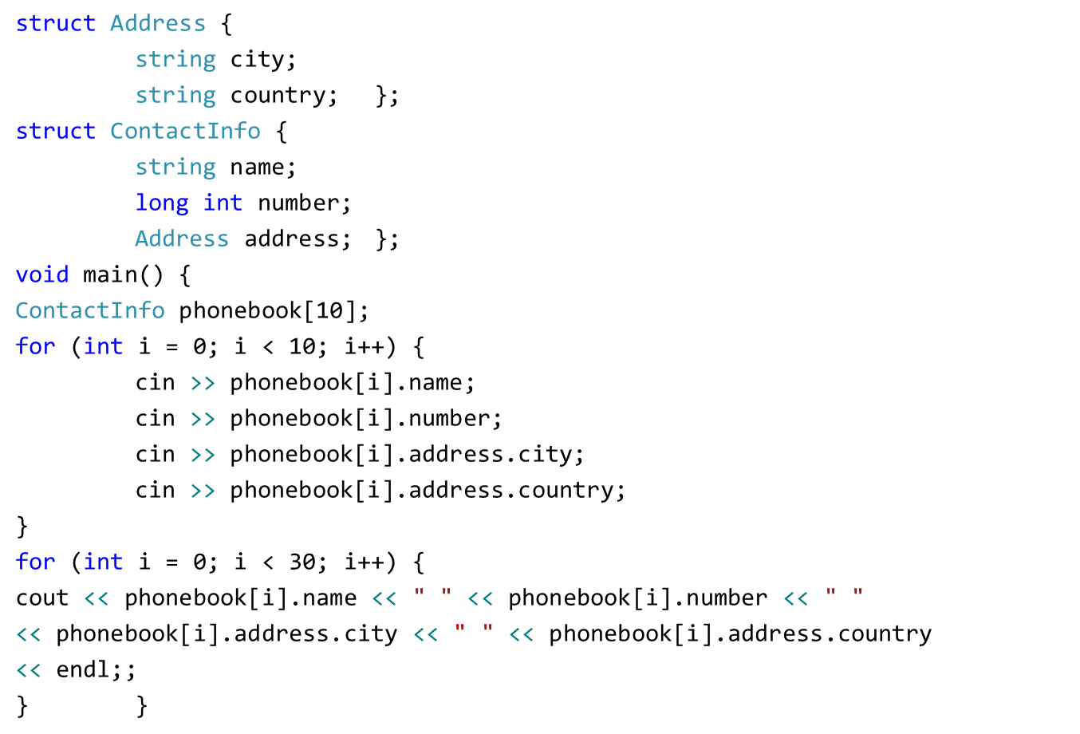
Practice Question

Slide 39
Pointers to Structures
A structure variable has an address
Pointers can be used to point to structure variables.
Pointers to structures are variables that can hold the address of a structure
Student *stuPtr;
The stuPtr pointer can point at variables of the type Student

Slide 40
Accessing Structures with Pointers
The pointer variable should be of the type:
Your Structure
struct Rectangle {
int width;
int height;
};
void main( )
{
Rectangle rect1 = {22,33};
Rectangle* rect1Ptr = &rect1;
}

Slide 41
Accessing Structures with Pointers
How to access the structure members (using pointer)?
Use dereferencing operator (*) with dot operator (.)
struct Rectangle {
int width;
int height;
};
void main( )
{
Rectangle rect1 = {22,33};
Rectangle* rect1Ptr = &rect1;
cout<<(*rectPtr1).width << endl;
cout<<(*rectPtr1).height << endl;
}

Slide 42
Accessing Structures with Pointers
Is there some easier way to do this?
Use arrow operator ( -> ) instead of * and .
struct Rectangle {
int width;
int height;
};
void main( )
{
Rectangle rect1 = {22,33};
Rectangle* rect1Ptr = &rect1;
cout<< rectPtr1->width << endl;
cout<< rectPtr1->height << endl;
}

Slide 43
Dynamic Memory Allocation
The pointer variable can be used to dynamically allocate memory for a structure variable:
struct Rectangle {
int width;
int height;
};
void main( )
{
Rectangle* rect1Ptr = new Rectangle;
rect1Ptr->width=22;
rect1Ptr->height=33;
}

Slide 44
Pointer as Structure Member
Pointers can also be a member of a structure
struct Rectangle {
int *width;
int height;
};
void main( )
{ int w = 3;
Rectangle rect1 = {&w,5}
*rect1.width = 2; //dot has higher precedence
rect1.height = 4;
}
Address of variable w is assigned to the pointer width

Slide 45
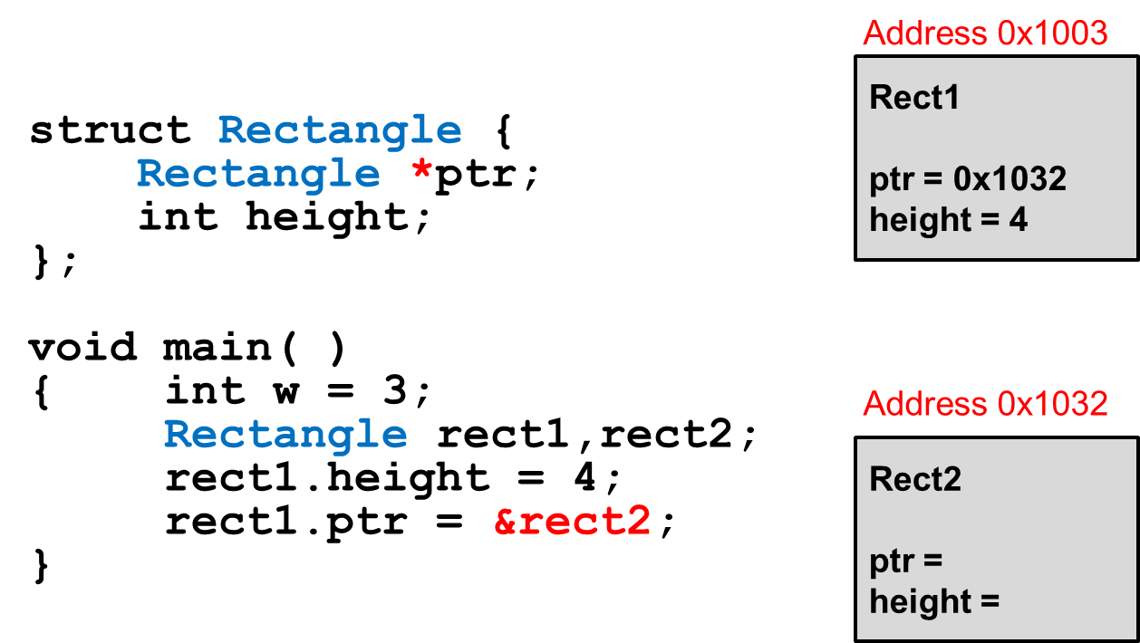
Pointer as Structure Member
Pointers can also be a member of a structure

Slide 46
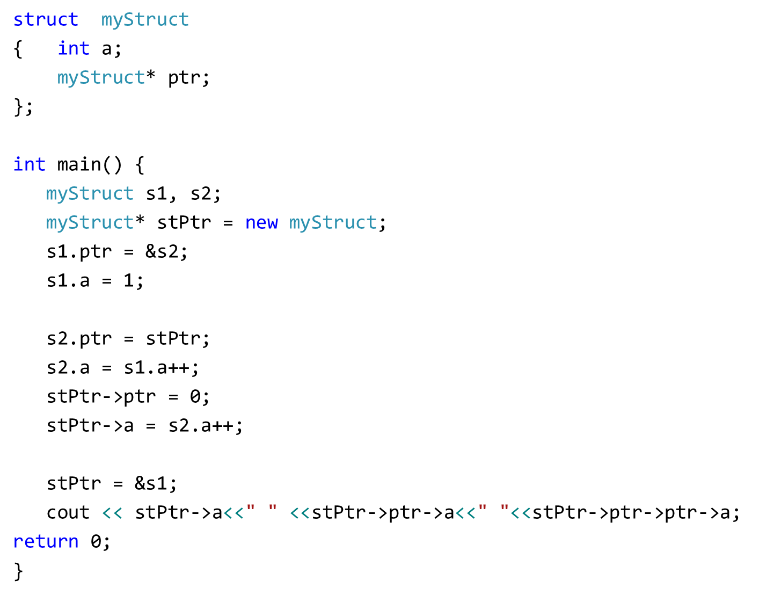
Output: 2 2 1
Post-increment, increments value after assignment

Slide 47
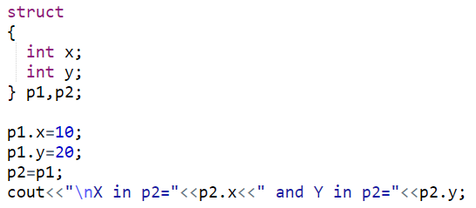
Anonymous Structure
Structures can be anonymous
Must create variable after declaration

Slide 48
Other Stuff You Can Do With a struct
You can also associate functions with a structure (called member functions)

Slide 49
Quick Example
struct StudentRecord {
string name; // student name
int marks[5]; // test grades
double ave; // final average
void print_ave( ) {
cout << "Name: " << name << endl;
cout << "Average: " << ave << endl;
}
};

Slide 50
Using a Member Function
Use the dot operator to call member functions of a struct
StudentRecord stu;
stu.print_ave( );

Slide 51
Structures as Function Arguments
May pass members of struct variables to functions:
//function definition
float computeGPA(float gpa){
……………
}
//function call
computeGPA(s1.gpa);

Slide 52
Structures as Function Arguments
May pass entire struct variables to functions
Pass-by-value
Pass-by-reference
Pass-using pointers

Slide 53
Structures as Function Arguments – Pass by Value
struct Rectangle {
double length;
double width;
double area;
};
void changeRect(Rectangle r) {
r.length = 5;
r.width = 6;
r.area = 30;
}
void main(){
Rectangle box = {1, 2, 2};
changeRect(box); }
A copy of the struct box is created and saved in the function parameter r

Slide 54
Structures as Function Arguments – Pass by Value
void changeRect(Rectangle r) {
r.length = 5;
r.width = 6;
r.area = 30;
}
void main(){
Rectangle box = {1, 2, 2};
changeRect(box);
cout << box.length << endl; prints 1
cout << box.width << endl; prints 2
cout << box.area << endl; prints 2
}

Slide 55
Structures as Function Arguments – Pass by Reference
The actual struct variable box is passed by reference (parameter r is just another name for box)
struct Rectangle {
double length;
double width;
double area;
};
void changeRect(Rectangle &r) {
r.length = 5;
r.width = 6;
r.area = 30;
}
Rectangle box = {1, 2, 2};
changeRect(box);

Slide 56
Structures as Function Arguments – Pass by Reference
void changeRect(Rectangle &r) {
r.length = 5;
r.width = 6;
r.area = 30;
}
void main(){
Rectangle box = {1, 2, 2};
changeRect(box);
cout << box.length << endl; prints 5
cout << box.width << endl; prints 6
cout << box.area << endl; prints 30
}

Slide 57
Structures as Function Arguments - Notes
Passing a structure to a function by value can slow down a program, waste space
Passing a structure to a function by reference will speed up program, but the function may change data in structure
Using a const reference parameter allows read-only access to reference parameter, it is fast and does not waste space

Slide 58
Structures as Function Arguments – Pass by const Reference
void changeRect(const Rectangle &r) {
r.length = 5;//ERROR! Cannot modify const
r.width = 6; //ERROR! Cannot modify const
r.area = 30; //ERROR! Cannot modify const
}
void main(){
Rectangle box = {1, 2, 2};
changeRect(box);
}

Slide 59
Structures as Function Arguments – Pass by const Reference
void showRect(const Rectangle &r) {
cout << r.length << endl;
cout << r.width << endl;
cout << r.area << endl;
}
void main(){
Rectangle box = {1, 2, 2};
showRect(box);
}
Output: 1
2
2

Slide 60
Returning a Structure from a Function
A Function can return a struct:
Student getStudentData(); // prototype
stu1 = getStudentData(); // call
Function must define a local structure variable
for internal use
for use with return statement

Slide 61
Returning a Structure from a Function - Example
Student getStudentData()
{
Student tempStu;
cin >> tempStu.studentID;
cin >> tempStu.yearInSchool;
cin >> tempStu.gpa;
return tempStu;
}

